Slide 1
Nursing Council Standards of Competence and scope 2025
Northern Region PDRP coordinators- an update
Notes:
Application of Pou into practice
Whats different

Slide 2
Current state
Under the Health Practitioners Competence Assurance Act 2003 Nursing Council New Zealand ( NCNZ)is required to determine scopes of practice and standards of competence.
NCNZ has introduced changes to enrolled and registered nurse scopes of practice and implemented Standards of Competence for nurses. These came in to being early 2025.
This means we need to develop practice under the changed scopes and to reflect on this
Notes:
With the move to HNZ we have align our portfolio evidential requirements nationally
There is lots of work going on at a national level to look at evidential requirements and how we prove competence and grow at all levels
Chief nurses /Council review of scope/EN scope changes/regional changes
NCNZ introduced changes to the scope of practice for ENs. and RNs coming into effect Jan 20th 2025
Under the HPCA ( 2023) NCNZ is required to determine scopes and standards of competence
These were last reviewed in 2016( RN) and ( EN 2012)
Please look at your scope and consider what changes there are and how this will impact in practice- you will be completing self assessments under the POU
Under review:
RN prescriber scope
Nurse Practitioner scope
The Council regularly reviews these documents to ensure nurses are equipped to meet the challenges of the current healthcare environment.
The revised Scopes and new Standards reflect contemporary nursing practice in Aotearoa both today and into the future.

Slide 3
Common Kupu
Pou: A pillar or anchor that supports and guides the foundations of practice
Whakapapa: understanding relationships and ancestry
Manaakitanga: care, respect and hospitality
Whanaungatanga: forming and maintaining relationships
Kawa Whakaruruhau: cultural safety in Māori context
Pūkengatanga: expertise, skill, competence, depth of knowledge and ability
Rangatiratanga: in nursing upholds the dignity, rights and values of all, addressing the needs and aspiration of Māori
Rongoa: traditional Māori medicine

Slide 4
Enrolled Nurses
Enrolled nurse scope of practice
Enrolled nurses in Aotearoa New Zealand reflect knowledge, concepts and worldviews of both tangata whenua and tangata tiriti.
Enrolled nurses uphold and enact ngā mātāpono – principles of Te Tiriti o Waitangi, based on the Kawa Whakaruruhau framework and cultural safety, promoting equity, inclusion, diversity, and rights of Māori as tangata whenua. These concepts also relate to Pacific peoples and all population groups to support quality services that are culturally safe and responsive.
Enrolled nurses are accountable and responsible for their nursing practice, ensuring that all health care provided is consistent with their education, assessed competence, relevant legislative requirements, supported by relevant practice standards, and is guided by the Nursing Council of New Zealand’s standards for enrolled nurses.
The enrolled nurse works in partnership and collaboration with individuals, their whānau, communities, and the interprofessional healthcare team, to deliver equitable person/whānau/whakapapa-centred nursing care, including advocacy and health promotion, across the life span in all settings.
An enrolled nurse’s practice is informed by their educational preparation and practice experience and may include a leadership or coordination role within the healthcare team.
Enrolled nurses partner with people receiving health and/or disability support services to initiate and monitor care through nursing assessments, care planning, implementation and evaluation of care.
Enrolled nurses must work with access to, and seek when appropriate, guidance from a registered nurse or other registered health practitioner.*
Notes:
The focus of both scope changes is to recognise Te Tiriti and kawa Whakaruruhau and cultural safety as foundational in practice
Enables greater breadth of practice across the lifespan and in all health settings- real expansion to the potential of ENs.
Recognises accountability of ENs. – should be practicing at the level of experience, assessed competence and experience.
No longer work under direction & delegation of RN but are responsible for seeking support when needed ( Health professional) - autonomous practice

Slide 5
Registered Nurses
Registered nurse scope of practice
Registered nurses in Aotearoa New Zealand incorporate knowledge, concepts and worldviews of both tangata whenua and tangata tiriti into practice.
Registered nurses uphold and enact ngā mātāpono – principles of Te Tiriti o Waitangi, based on the Kawa Whakaruruhau framework and cultural safety, promoting equity, inclusion, diversity, and rights of Māori as tangata whenua. These concepts also relate to Pacific peoples and all population groups to support quality services that are culturally safe and responsive.
Registered nurses are accountable and responsible for their nursing practice, ensuring that all health care provided is consistent with their education, assessed competence, relevant legislative requirements, and is guided by the Nursing Council of New Zealand’s standards for registered nurses.
Registered nurses use substantial scientific and nursing knowledge to inform comprehensive assessments, determine health needs, develop differential diagnoses, plan care and determine appropriate interventions. Interventions are evaluated to assess care outcomes based on clinical judgement and scientific and professional knowledge.
Registered nurses practise independently and in collaboration with individuals, their whānau, communities, and the interprofessional healthcare team, to deliver equitable person/whānau/ whakapapa-centred nursing care across the life span in all settings.
Registered nurses may also use their expertise in areas and roles such as leadership, management, education, policy and research.
Conditions may be placed on the scope of practice of some registered nurses, dependent on their qualifications and/or experience, limiting them to a specific area of practice. Nurses who have additional experience and have completed the required education will be authorised by the Council to prescribe some medicines within their area of practice and level of competence.
Registered nurses are responsible and accountable for directing and delegating to members of the healthcare team. Registered nurses provide support and guidance to enrolled nurses.
Notes:
The focus of both scope changes is to recognise Te Tiriti and kawa Whakaruruhau and cultural safety in practice
Recognises the importance of scientific and nursing knowledge to inform comprehensive assessments, determine health needs and develop differential diagnosis, plan care and determine appropriate interventions.
Responsible for providing whakapapa centred care and for providing support and guidance to ENs. , direction and delegation to other team members
This level of evidence and critical thinking does develop across your career and from novice to expert.
The six pou together reflect the complexity of both health needs and the interventions required for nursing practice and the provision of care. This complexity requires a change in required competence as the need for critical thinking and reasoning, differential diagnoses, and professional judgement based on evidence, is essential. To provide care in this environment, sound clinical, cultural and scientific knowledge to support decision-making is fundamental to ensuring safe care.
For care to be effective, collaborative and compassionate, relationships based on trust, partnership and acceptance of diversity are fundamental. Achieving this requires skill in communication and an understanding of the range of communication styles and appropriate strategies. An understanding of the need for different forms of communication enables the nurse to influence the interprofessional healthcare team, advocate for innovative change where appropriate and influence the direction of the profession.

Slide 6
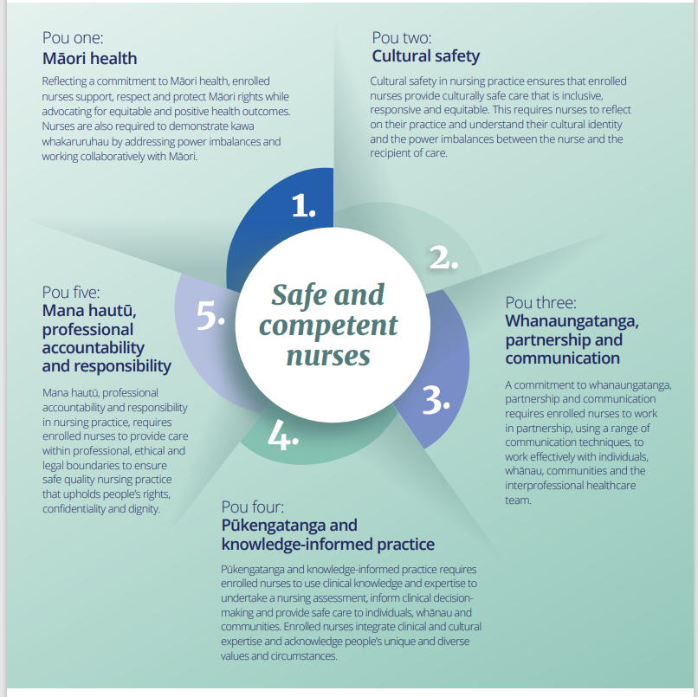
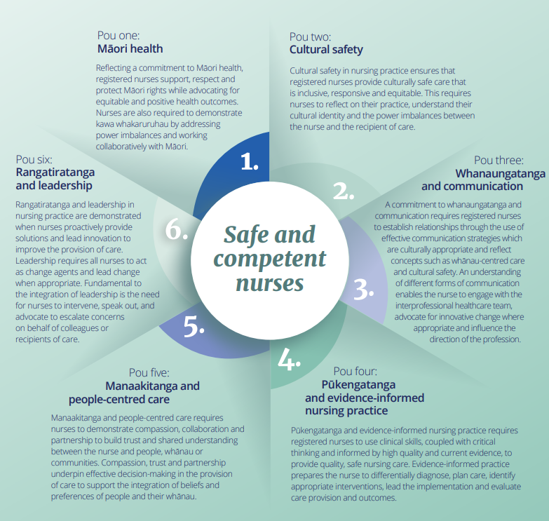
Standards of Competence
Notes:
The standards of competence are structured to identify the key areas of competence across all practice settings; these are the six pou for RNs and 5 for ENs , following recent updates these are more closely aligned.. Each pou has a set of descriptors which provides further depth and detail of the requirements to meet the pou. The Council has developed the six pou and descriptors, in collaboration with the sector and stakeholders, to identify and separate the fundamental elements of nursing practice and enable the assessment of aspects of practice when required. Each pou is interrelated and demonstrated in practice simultaneously. When practicing, a nurse will be integrating aspects of each pou where they relate to their area of practice using a range of scientific, relational and cultural, evidence-based knowledge to provide effective care to people, whānau and communities.
These POU generally cover different aspects of nursing practice aligned to your scope.

Slide 7
Writing to the Pou
Use examples specific to your nursing practice in your current role.
Be Specific
This enables the manager to sign off on your practice with confidence
Read the narrative under each Pou heading, you need to write to this .
Write to the whole Pou
You don’t need to write to each descriptor – these are guides to help you ensure your practice meets the Standard of Competence
Notes:
When writing to the Pou think about how you practice on a daily basis
Think of an occasion when your practice reflects one of the descriptors
Maintain confidentiality
Set the scene – what happened and what did YOU do ?
Avoid generalised statements such as I always do ……

Slide 8
Pou one: Māori health
Reflecting a commitment to Māori health, registered nurses support, respect and protect Māori rights while advocating for equitable and positive health outcomes. Nurses are also required to demonstrate kawa Whakaruruhau by addressing power imbalances and working collaboratively with Māori.
The descriptors below identify the requirements for registered nurses working in partnership with Māori.
Descriptor 1.1 Engages in ongoing professional development related to Māori health and the relevance of te Tiriti o Waitangi articles and principles.
Descriptor 1.2 Advocates for health equity for Māori in all situations and contexts.
Descriptor 1.3 Understands the impact of social determinants, such as colonisation, on health and wellbeing.
Descriptor 1.4 Uses te reo and incorporates Tikanga Māori into practice where appropriate.
In my practice when I encounter Māori patients it is vital for me to incorporate Te Tiriti O Waitangi in my practice. One specific example of this was when a three your old boy presented with his father, grandparents and siblings. He had a flare up of eczema, was dehydrated and was also not up to date with their immunisations due to family stressors and poor accessibility to healthcare. I am aware that due to multiple social determinants of health and health disparities Māori individuals face they can be disadvantaged in the healthcare system and can often lack the resources and support to receive adequate healthcare.
I introduced myself by saying "Kia Ora’ and orientated whanau to where the whanau room as their involvement is important for Māori values and beliefs. I showed them where the beverage station and playroom were, I noticed the father becoming stressed by siblings running around. During my assessments I tried to use Māori phrases, this builds better rapport and trust with the child. In this case I refer to body parts such as "puku" for his stomach and "waewae" for legs while applying cream. I also used phrases such as "kapai" when he was doing a good job at being still and taking his paracetamol.
I also I noticed that this father potentially lacked information about care for his child and was very stressed about being in hospital. I spend some time with him to find out his needs and provided some education and information to him and the whanau father and supporting whanau on when to come into hospital and on signs and symptoms especially for re-presenting to hospital, ways to administer medications and fluids, applications of ointments and dressings, and ways to reduce scratching.
I also upheld the tikanga principles during my cares and promoted partnership by involving the father with the ointment application and paracetamol administration as the father told me that he struggled with this. In doing so he could leave the hospital with knowledge on how to do this when at home. During my care for this child, I ensured to maintain the concept of tapu and noa and ensured to never placed medical supplies on the tray tables or bed space such as medications or wound dressings.
I try to advocate for my patients and in this case, I did in three ways., I referred them to the Māori support services to find out ways to access support at home and in the community. This supported better care and me to understand more about meeting their needs. I also provided culturally safe care by providing leaflets to the father about local Māori health services including local free immunisation services that the child can receive in the community. Upon discharge I referred them to home healthcare for paediatrics so they can receive extra skin treatment and management support at home ,I also provided the father with extra medical supplies for at home such as medication syringes.
Notes:
Te tiriti care is around mana enhancing care, making sure that people are in charge or at least have a place at the table around their care and delivery of care that they receive when they are with us. That takes years to learn and develop but the takeaway is that partnership is at the forefront. Negative experiences really follow the patient to their next engagement so if you are able to highlight ways you are making experiences positive so that can flow onto future engagement…I think that starts to show thinking and understanding toward one part of the history Māori have within the health system. Best care for Māori is best care for everyone.
This Pou aims to assess your understanding of Te Tiriti and how its principles are applied to nursing practice, this includes knowledge of Tikanga and equitable outcomes. It also takes into account some of the social determinants of care to ensure as nurses we provide care which is viewed as safe and responsive to the needs of Maori . specific behaviours, attitudes, and interactions that reflect culturally safe practice, how they respect the person’s cultural identify, beliefs and values and use supports in care.
Seeks guidance when unsure about tikanga practices and respects Māori perspectives on health and wellbeing , demonstrates respect for tapu and noa, understands collective care principles
Understands inequities and social constructs

Slide 9
Pou two: Cultural safety
Cultural safety in nursing practice ensures that registered nurses provide culturally safe care that is inclusive, responsive and equitable. This requires nurses to reflect on their practice, understand their cultural identity and the power imbalances between the nurse and the recipient of care.
The descriptors below identify the requirements to ensure culturally safe nursing practice.
Descriptor 2.1 Practises culturally safe care which is determined by the recipient.
Descriptor 2.2 Challenges racism and discrimination in the delivery of nursing and health care.
Descriptor 2.3 Engages in partnership with individuals, whānau and communities for the provision of health care.
Descriptor 2.4 Advocates for individuals and whānau by including their cultural, spiritual, physical and mental health when providing care.
Descriptor 2.5 Contributes to a collaborative team culture which respects diversity, including intersectional identities, and protects cultural identity by acknowledging differing worldviews, values and practices.
Mr X was a 65 year old patient who was admitted to the hospital due to abdominal pain. Mr X was of Indian descent and spoke minimal English. While caring for Mr X, there was a language barrier noted and therefore an interpreter was booked for the ward rounds to ensure that the patient was able to communicate his needs to the doctors and that important assessments were captured during the rounds. As the nurse caring for this patient, I also ensured to take part in the ward rounds so that I could use the interpreter and also do my assessments. The interpreter also assisted in explaining a visual tool used for the pain scale so that the patient could communicate his pain whilst in hospital. As per the interpreter, the patient voiced that he would like his son to be informed of all care and treatment. I called the son as per patient’s request and include him in the patient’s care and plans. This patient was diagnosed with cholelithiasis and choledocholithiasis and agreed to cholesyectomy. As part of the pre-op checklist, I asked him about his jewellery to which he disclosed with assistance of interpreter that he would like to keep his necklace on during the surgery as it was an important part of his religion and culture. I noted this on the pre-op checklist and made note of it during t handover and ensured that the patient would keep it during the procedure and be included in post op counts. This supported the patient to express his needs and communicate openly during admission and voice his cultural needs and requests. This led him to feel more comfortable during his stay in hospital.
Notes:
Pou two builds on the principles of Pou one – extending the concept of cultural safety to encompass all people , whanau and communities who receive nursing care in NZ. You need to demonstrate the ability to provide care that is respectful of patients specific cultural needs – this is not limited to ethnicity …..
We must ensure inclusivity and cultural responsiveness, challenge racism and discrimination, and engage with patients, whanau and communities
Again we need to show how we advocate for patients understand how to ask and assess their needs and reflects on cultural diversity
Cultural Safety & Sensitivity – You recognized the patient’s cultural background and language barrier and took steps to ensure he could communicate effectively. This demonstrates respect for cultural diversity and patient-centered care.
Effective Communication – You arranged an interpreter, enabling clear communication between the patient, healthcare team, and his family, ensuring informed decision-making.
Partnership & Patient Autonomy – You involved the patient in his care, respected his request to keep his religious necklace, and communicated his wishes to the surgical team.
Family Involvement – By contacting his son as per his request, you upheld the patient’s right to involve whānau in his care, reflecting NCNZ’s emphasis on family-centered care.
Advocacy & Equity – Ensuring his cultural and spiritual needs were met before surgery highlights your role as an advocate and aligns with the principles of equitable care.

Slide 10
Pou three: Whanaungatanga and communication
A commitment to whanaungatanga and communication requires registered nurses to establish relationships through the use of effective communication strategies which are culturally appropriate and reflect concepts such as whānau-centred care and cultural safety. An understanding of different forms of communication enables the nurse to engage with the interprofessional healthcare team, advocate for innovative change where appropriate and influence the direction of the profession.
The descriptors below identify the requirements for effective communication with individuals, whānau and the wider healthcare team.
Descriptor 3.1 Understands and complies with professional, ethical, legal and organisational policies for obtaining, recording, sharing and retaining information acquired in practice.
Descriptor 3.2 Determines the language and communication needs (verbal and non-verbal) of people, whānau and communities.
Descriptor 3.3 Incorporates professional, therapeutic and culturally appropriate communication in all interactions.
Descriptor 3.4 Communicates professionally to build shared understanding with people, their whānau and communities.
Descriptor 3.5 Assesses health-related knowledge, provides information and evaluates understanding to promote health literacy.
Descriptor 3.6 Ensures documentation is legible, relevant, accurate, professional and timely.
Descriptor 3.7 Uses appropriate digital and online communication
Descriptor 3.8 Provides, receives and responds appropriately to constructive feedback.
Notes:
This Pou emphasises the importance of establishing and maintaining effective relationships through culturally appropriate communication.
how well they establish relationships, communicate effectively, and adapt their communication to different contexts
Provides education to patients/whanau – language, other tools, uses feedback method, checks understanding, looks for non verbal cues
Utilises appropriate te roe language
Communication, including digital tools/platforms
Writes clear concise notes – in a timely manner
Understands risk of social media
Whanaungatanga refers to the process of building relations, connecting and belonging, it supports the need for advocacy. It incorporates relationship and kinship emphasising the importance of connections and relationships
This will look at your understanding of effective communication techniques, conflict resolution and therapeutic relationships, with a focus of culturally sensitive communication in the NZ context.
Nurses should consider whanau centred approaches to care , recognising the importance of this in health outcomes.

Slide 11
Pou three example
To support whānau-centred care and uphold cultural safety, I needed to communicate effectively with a baby’s parents to build shared understanding and health education for their infant with safe sleep. This teaching is a part of discharge preparation when transferring an infant from an incubator to a cot, a milestone that requires whānau involvement. Prior to the session, I reviewed the Safe Sleep policy to ensure my guidance aligned with best practice.
I provided pamphlets to explain the baby’s head and airway anatomy and the risks associated with unsafe sleep environments. I highlighted that infants are nose breathers and must sleep in their own bedspace, flat on their backs, with no pillows, toys, or loose bedding. I explained the importance of a firm, flat mattress with no gaps, and positioning the infant with feet at the bottom of the cot. I showed whānau the safe sleep poster displayed in each bay as reminders.
I also discussed swaddling techniques, ensuring it was done below the shoulders to prevent airway obstruction. I clarified why hospital sleep positioning may differ, such as propped cots for gastric issues, emphasising that this is not safe at home due to the lack of continuous monitoring.
Throughout the session, I encouraged questions and listened respectfully to whānau experiences, including cultural practices like co-sleeping. I acknowledged their views without judgement, which helped build trust and mutual respect. Whānau expressed that the session was informative and appreciated the safety rationale.
To reinforce learning, we have a quiz where whānau answered in their own words. This helped identify and correct any misunderstandings, boosted their confidence and understanding of safe sleep practices to protect their infant from risks such as sudden unexpected infant death.

Slide 12
Pou four: Pūkengatanga and evidence-informed nursing practice
Pūkengatanga and evidence-informed nursing practice requires registered nurses to use clinical skills, coupled with critical thinking and informed by high quality and current evidence, to provide quality, safe nursing care. Evidence-informed practice prepares the nurse to differentially diagnose, plan care, identify appropriate interventions, lead the implementation and evaluate care provision and outcomes.
The descriptors below identify the requirements for the registered nurse to coordinate, manage, lead and evaluate the delivery of quality care.
Descriptor 4.1 Understands the wide range of assessment frameworks and uses the appropriate framework to undertake comprehensive assessments in the practice setting.
Descriptor 4.2 Develops differential diagnoses based on a comprehensive assessment, clinical expertise and current evidence to inform the plan of care.
Descriptor 4.3 Implements and evaluates effectiveness of interventions and determines changes to the plan of care.
Descriptor 4.4 Coordinates and assigns care, delegates activities and provides support and direction to others.
Descriptor 4.5 Safely manages medicines based on pharmacotherapeutic knowledge, including administration in accordance with policies and best practice guidelines.
Descriptor 4.6 Supports individual and whānau choices of complementary therapies by ensuring they have sufficient information to make informed decisions about treatment options.
Descriptor 4.7 Understands cultural preferences for complementary treatment, such as the use of Rongoa, and supports integration into care.
Descriptor 4.8 Demonstrates digital capability and online health literacy to support individuals, whānau and communities to use technology for managing health concerns and promoting wellbeing.
Descriptor 4.9 Applies infection prevention and control principles in accordance with policies and best practice guidelines.
Descriptor 4.10 Identifies, assesses and responds to emerging risks and challenging situations by adjusting priorities and escalating to the appropriate person.
Descriptor 4.11 Understands and works within the limits of expertise and seeks guidance to ensure safe practice.
Descriptor 4.12 Maintains awareness of trends in national and global nursing to inform change in practice and delivery of care.
Notes:
Pou four is the most significant change for Registered nurses – it focuses on the application of scientific , evidence based nursing knowledge and care. This includes evidence of critical thinking and understand of differential diagnosis and identification of appropriate interventions . It aims to review your understanding of pharmacology, pathophysiology, nursing interventions and your ability to apply this knowledge to practice across a variety of settings. If you don’t work clinically you are still able to show how you support others to do this, consider what is happening locally, regionally and nationally to ensure we maintain contemporary practice , respond to emerging risks, and support professional growth and competence.
Pūkengatanga refers to skills , knowledge and expertise – consider how you use this to support safe practice, professional development and growth
providing safe nursing care and everything that may entail.
Observe real clinical interactions and decision-making. Provide specific, behaviour-based feedback that acknowledges strengths and areas for growth. Encourage reflection and self-assessment in clinical debriefs.

Slide 13
Pou four example
Understands the wide range of assessment frameworks and uses the appropriate framework to undertake comprehensive assessments in the practice setting.
A recent episode of care I was involved in was when I was caring for Mrs Jones, a 76-yr old female who was admitted to the ward with shortness of breath and fatigue. As I was proceeding to administer her morning medications she complained of chest pain. To assess her chest pain, I used the COLDSPA pneumonic:
Character: tight, heavy sensation- not stabbing or sharp
Onset: It started this morning about an hour ago.
Location: centre of chest- does not radiate elsewhere.
Duration: ongoing since it started.
Severity: 7/10.
Pattern: Worse when lying flat, relieved when sitting up.
Associated factors: short of breath/ankle swelling
Wanting to ensure her safety I asked a senior colleague for support. She advised to reposition Mrs Jones upright to help her breathing. I took a set of vital signs and ECG. I then contacted the medical team caring for Mrs Jones to advise. At that point she did not require O2.
During this episode and whilst waiting for the team to review I referred to the Chest pain Policy. I was concerned this pain was cardiac in origin due to her history of Unstable Angina. Mrs Jones did have GTN spray charted PRN; I administered 1 puff and after rechecking her vital signs after 5 mins Mrs Jones continued to experience chest discomfort. In discussion with my senior colleague; I administered a further puff of GTN as per policy. The medical team arrived to review Mrs Jones; I remained with her to see what further interventions were required and to provide support.

Slide 14
Pou five: Manaakitanga and people-centred care
Manaakitanga and people-centred care requires nurses to demonstrate compassion, collaboration and partnership to build trust and shared understanding between the nurse and people, whānau or communities. Compassion, trust and partnership underpin effective decision-making in the provision of care to support the integration of beliefs and preferences of people and their whānau.
The descriptors below identify the requirements for ensuring person and whānau-centred care.
Descriptor 5.1 Ensures integrated relational and whakapapa-centred care to meet the needs of people and whānau.
Descriptor 5.2 Upholds the mana of individuals, whānau and the nursing profession by demonstrating respect, kindness, honesty and transparency of decision-making in practice.
Descriptor 5.3 Facilitates opportunities for people and whānau to share their views and actively contribute to care planning, decision-making and the choice of interventions.
Descriptor 5.4 Establishes, maintains and concludes safe therapeutic relationships.
I accommodate my care to the patient’s preferences of attending appointments, with their whanau, by creating the space and time to demonstrate collaboration and partnership. During a consultation with Mr W for a wound review, I talked with both Mr W and his wife and discussed my wound assessment. I asked Mr W and his wife if they noted any change to the wound. I modified the language I used during this conversation to ensure they were able to comprehend. I provided them with safe and appropriate options regarding dressing choice to promote and support their contribution to their care planning.
Another example is during scheduled vaccination visits for a 15-month-old child I discussed with the whanau the 3 vaccinations their child is due. Patients, and in this situation, the whanau, are within their right to decline vaccinations or adjust the schedule if they wish to do so. Master B’s parents preferred to keep the vaccines administered today at a maximum of 2.
I listened to their reasoning in a respectful and kind manner to identify concerns. I discussed best practice recommendations and informed the parents of the benefits of recommended guidelines to ensure they were able to make an informed decision. The parents maintained their decision to only have 2 vaccines today. I upheld their mana and provided my nursing care demonstrating respect for the parents. I ensure all documentation and recalls are written accordingly to ensure the vaccination schedule is maintained for this child.
Notes:
This Pou requires nurses to incorporate both clinical and cultural need into patients care, you need to show how compassion, collaboration and partnerships are demonstrated in practice and how you integrate relational and whakapapa centred care. Maintains boundaries , builds trust, respectful relationships, communicates clearly
Observe genuine patient interactions and relationship-building efforts. Encourage whānau involvement and culturally responsive practices. Provide specific feedback that highlights strengths and areas for growth.
I have added a community example and in patient example

Slide 15
Pou five example
During a morning shift, I received a handover about a female patient who had just been brought into the department with shortness of breath and fever. The night RN hadn’t yet completed her assessment but mentioned the patient had been diagnosed with breast cancer and had chemotherapy the previous day.
Before entering the room, I ensured I was wearing the appropriate cytotoxic PPE for both my safety and the patient’s. When I introduced myself, I explained my role and that I would be completing an assessment and some diagnostic tests. I asked for her name and her husband’s, and as we began talking, she opened up about her recent diagnosis. She was only 35 years old with two young daughters, she and her husband were emotional as they shared their recent experiences. She told me how they had been planning a family holiday just months earlier, but now they were preparing for her funeral after being told her cancer had spread and her prognosis was poor. My heart ached for this young family and I felt determined to make their time in our department as supportive and stress free as possible. I asked how I could best support them and if there were any cultural or religious beliefs they wanted upheld. She shared that she was a Christian, and her faith gave her hope that a miracle might still happen and if not, that God would be with her little girls. I offered them privacy for prayer, which she appreciated. When she asked if her daughters could visit, I arranged space for them and brought over some crayons, toys and bubbles from the paediatric department. I got to hear and observe a few giggles and hugs between the family as they spent time in the department, knowing that I was able to not only accommodate her young family, but provide a relaxed and caring environment where they were able to spend meaningful time together.
When her lab results returned, they showed signs of kidney and heart failure. The plan was to transfer her to the ADU for monitoring and further tests. When I explained this, she became tearful, saying she’d been in ADU a few weeks earlier and found it distressing, explaining that she was placed in a corridor with no space for her children and surrounded by other unwell patients. She worried about exposure to infections that could shorten the time she had left. I discussed my patients concerns with my charge nurse asking if we could ensure she has a bed space before moving her, which my charge nurse helped me to arrange. I informed the patient and her husband that their needs were heard and would be respected. Once a space was ready, I transferred them myself. I asked the receiving nurse to come into the room so I could hand over the patient’s needs and preferences in front of her and her whanau. I explained that her religion and family connection were important parts of her care, and that her previous experience in ADU had been difficult. After we left the room, I gave the clinical handover privately, as my patient had requested no medical details be shared in front of her children. The nurse taking over her care understood the situation and was determined to continue with the person centered care that had already been provided.
Before leaving, I offered to refer her and her family to social work for ongoing support, which she accepted. As I said goodbye, my patient thanked me for all the love and care I gave to her and the family and showed me a drawing her little girl made with the 4 of them and me in the drawing as their nurse. I was so touched by them and felt so blessed that I was able to care for them that day, knowing that I was able to support not just her physical needs, but her emotional, spiritual, and whanau wellbeing as well.

Slide 16
Pou six: Rangatiratanga and leadership
Descriptor 6.1 Actively contributes to a collaborative team culture of respect, support and trust.
Descriptor 6.2 Demonstrates professional and ethical accountabilities in practice and adheres to the Nursing Council of New Zealand Code of Conduct, relevant legislation and organisational policies and procedures.
Descriptor 6.3 Understands continuous learning and proactively seeks opportunities for professional development.
Descriptor 6.4 Engages in quality improvement activities.
Descriptor 6.5 Identifies and responds appropriately to risk impacting the health, safety and wellbeing of self and others to practise safely.
Descriptor 6.6 Understands the impact of healthcare provision on global and local resources, demonstrates and supports the constant assessment and improvement of sustainability practices.
Rangatiratanga and leadership in nursing practice are demonstrated when nurses proactively provide solutions and lead innovation to improve the provision of care. Leadership requires all nurses to act as change agents and lead change when appropriate. Fundamental to the integration of leadership is the need for nurses to intervene, speak out, and advocate to escalate concerns on behalf of colleagues or recipients of care.
The descriptors below identify the requirements for the registered nurse to lead and work effectively as part of an interprofessional healthcare team.
Notes:
This requires nurses to show leadership, ethical care and understand their accountability/confidentiality/privacy
Look for contribution to the team- quality improvement and recognising/acting on gaps
Advocates for safe practice
Evidence of reflection on learning- understands learning is lifelong – seeks feedback on practice
Conferences, education hours, PG study, self directed learning and at higher levels learning of others

Slide 17
Pou six: Rangatiratanga and leadership
I attend all clinical and administrative meetings.
I actively engage and collaborate during meetings with ideas or comments to actively contribute. I seek to engage and create professional relationships with all members of the practice including non-clinical staff to contribute to a collaborative team culture. An example of this is when I noticed a new receptionist being abrupt in her manner with patients and staff, I escalated this to the nurse lead.
I maintained confidentiality by discussing my concerns in a private area and not sharing them with the rest of the team.
This contributes to a culture of respect and trust.
I have registered with appropriate professional organisations such as IMAC, Medinz and PHO bulletins to receive notifications and updates on appropriate changes or developments. I recently attended a IMAC, Flu and RSV update. I then shared this learning at the next team meeting so my colleagues were also updated with current changes. I maintain a record of my professional development for my portfolio.

Slide 18
Portfolio expectations – what's new ?
What's in ?
Attestation by senior nurse
Self-assessment against each pou
One portfolio template
Assigning the level of practice, you are applying for
Level of practice expectations
Aligning EN’s to Expert
AI attestation
Linking education to a pou
Lots of moderation over the next 12 months to ensure consistency
What’s out ?
CV
Appraisal
Separate templates for each level of practice
Writing to each competence/descriptor
Reflections on learning
Notes:
This Pou highlights the legal, ethical and professional responsibilities of nurses.

Slide 19
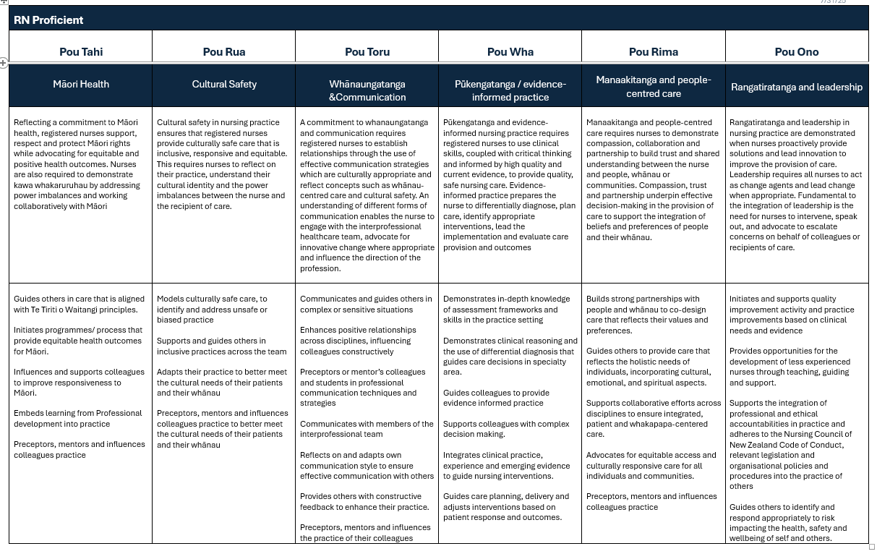
Notes:
Changes to expectations of levels of practice – will be released in framework documents

Slide 20
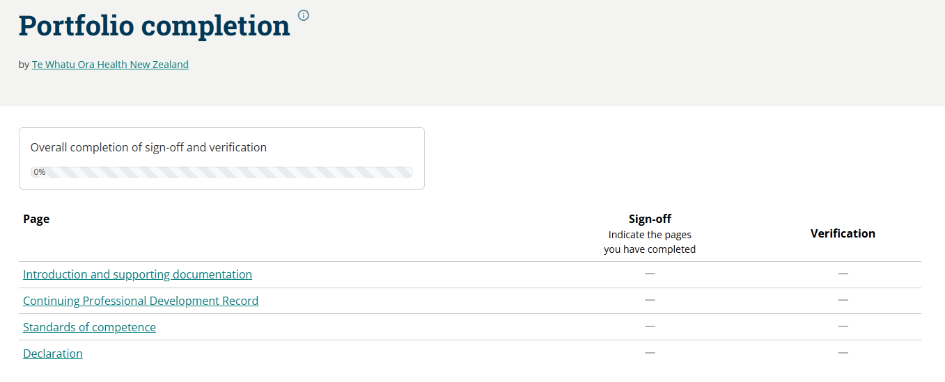
Notes:
One portfolio for registered nurses and one for enrolled – no difference in expected levels – however, you have to write to the pou AND the expectations of your LOP
One single SA – a specific example of practice
An attestation by a senior nurse – this should be your line manager or professional lead if your line manager is not a nurse
Any concerns please contact the PDRP team.

Slide 21

Questions ?

